Slide 1

VIVA
Minor Project-2 Summer Semester-2024-25
Department of Electronics and Communication Engineering
Channel and Spatial attention based CNN model for Texture image analysis
Signal processing Domain
30-10-2024
Project Team Members:
VTU 20732(Y.Ashok)
VTU 20755(M.Srikanth)
VTU 21271(N.Prasad)
Supervisor: Dr.V.Gnanaprakash
Assistant Professor

Slide 2
Content:
Introduction
Abstract
Objective
Zeroth Review comments and Response
Literature survey
Proposed Methodology/Algorithm/Model
Design/Implementation & Description
Results and Discussion
Work to be Carried-out
References

Slide 3
Introduction:
Channel and spatial attention-based CNN (Convolutional Neural Network) models have shown remarkable success in a variety of image processing tasks, including texture image analysis.
The integration of attention mechanisms enhances the model's ability to focus on important features by adaptively adjusting the importance of different regions or channels in the input data.
Here's a breakdown of how channel and spatial attention mechanisms work within a CNN for texture image analysis. Convolutional Neural Networks (CNNs) for Texture Image Analysis.
CNNs are a class of deep neural networks widely used for image classification, segmentation, and other image-related tasks.
For texture image analysis, CNNs can automatically learn spatial hierarchies of features, which is crucial for understanding complex texture patterns.
The network extracts features at various levels of abstraction, starting from low-level features (edges, corners) to higher-level patterns (texture patches).

Slide 4
Abstract:
CNN models to date only extract the global features of architecture facade or focus on some regions of architecture and fail to extract the spatial features of different components. To improve the accuracy of architectural style classification, we propose an architectural style classification method based on CNN and channel–spatial attention.
We collected a dataset of dog and cat images for image classification, labeling cats as 0 and dogs as 1.
The aim is to extract channel and spatial attention features from the images. For classification, we will utilize the CNN modules from VGG16, VGG19, and ResNet-50 to classify the images based on these features.

Slide 5
Objective:
The objective is to develop a CNN model incorporating channel and spatial attention mechanisms for enhanced texture image analysis.
A channel and spatial attention-based CNN model for texture image analysis is to leverage the attention mechanisms to improve the model's ability to analyze, classify, and segment texture images by focusing on the most relevant features and regions.

Slide 6
Literature Survey
Title | Author | Year | Journal | Description
Architectural style classification based on CNN and channel–spatial attention | Sulan Zhang | 2022 | Computer Science and Technology | The author analysed a deep learning approach to classifying architectural styles using a Convolutional Neural Network (CNN) and channel-spatial attention mechanisms
SSTNet: Spatial, Spectral, and Texture Aware Attention Network using Hyperspectral Image for Corn Variety Identification. | Weidong Zhang and Zexu Li | 2019 | School of Information Engineering | author analysed by combining spatial, spectral, and texture-aware attention mechanisms with hyperspectral imaging, SSTNet is able to more accurately identify corn varieties based on nuanced differences in their spectral signatures and textures.

Slide 7
Title | Author | Year | Description
SCA-Net: A Spatial and Channel Attention Network for Medical Image Segmentation | TONG SHAN AND JIAYONG YAN | 2021 | Author analysed SCA-Net enhances the network's ability to focus on critical areas in medical images, leading to more accurate segmentation results, which is crucial in medical applications like diagnostics and treatment planning.
Combined Channel and Spatial Attention-based Stereo Endoscopic Image Super-Resolution | Dr. Titipat Achakulvisut | 2020 | Author analysed Stereo Imaging technology integration into medical diagnostics and surgeries brings a great revolution in the field of medical sciences.

Slide 8
Title | Author | Year | Journal | Description
CNN Cloud Detection Algorithm Based on Channel and Spatial Attention and Probabilistic Upsampling for Remote Sensing Image. | Jing Zhang | 2021 | PhD. degree in information and communication engineering. | Author analysed Compared with other ground objects, cloud pixels in remote sensing image are invalid information, so it is a meaningful research work to remove cloud before transmitting image and reduce the waste of useless information.

Slide 9
CNN Algorithm:
A Convolutional Neural Network (CNN) is a type of Deep Learning neural network architecture commonly used in Computer Vision. CNN is the extended version of artificial neural networks (ANN) which is predominantly used to extract the feature from the grid-like matrix dataset.
VGG16, VGG19, and ResNet-50 are popular CNN architectures:
1. VGG16 (Visual Geometry Group 16)
- Layers: 16 weight layers (13 convolutional layers and 3 fully connected layers).
- Key Feature: Uses small (3 times 3) filters consistently throughout the network. It stacks multiple convolution layers before max-pooling layers, which helps in capturing detailed features.
- Performance: High accuracy but requires a large amount of computation and memory.
2. VGG19
- Layers: 19 weight layers (16 convolutional layers and 3 fully connected layers).

Slide 10
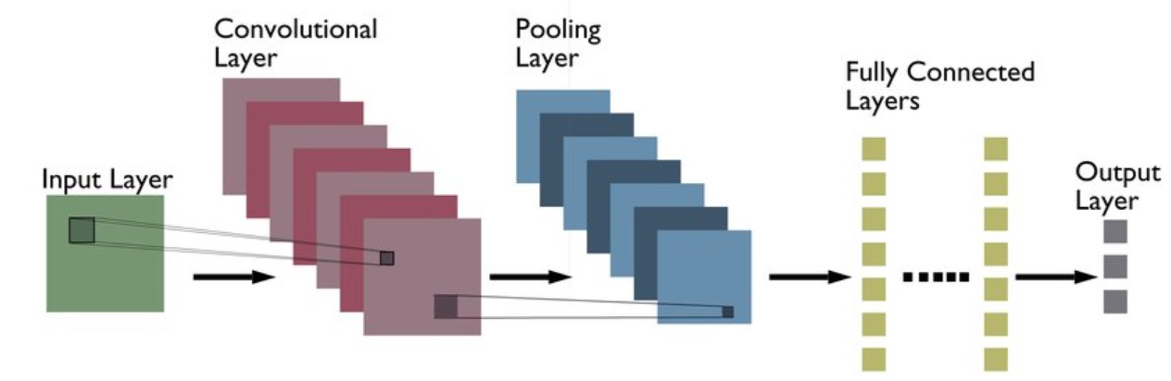
- Key Feature: Similar to VGG16, but with more convolutional layers. The increased depth can capture more complex features, but this also increases the model size and training time.
- Performance: Slightly higher accuracy than VGG16 but with similar challenges in terms of resource usage.
3. ResNet-50 (Residual Network)
- Layers: 50 layers with residual connections.
- Key Feature: Introduces skip connections or residual connections, which help solve the vanishing gradient problem by allowing gradients to flow directly through the network.
- Performance: Deep architecture with significantly fewer parameters compared to VGG networks and higher accuracy, thanks to the efficient use of residual blocks.

Slide 11
Methodology:
Testing
CNN Module
(VGG16 ,VGG19 & ResNet-50)
Result Analysis
&
Test
Data Collection
&
Presentation
Training &
Validation
Highest Accuracy
Classification
CAT
(0)
DOG
(1)

Slide 12
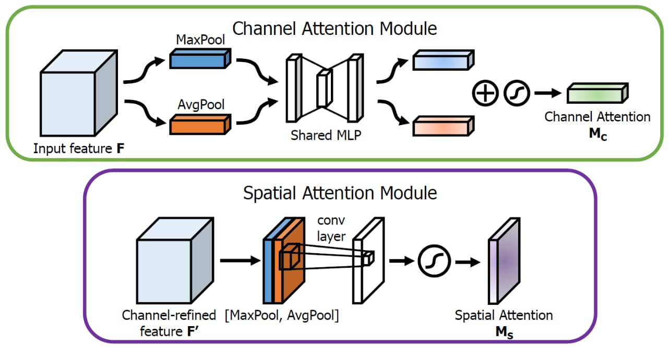
Block Diagram:

Slide 13
We collected a dataset of dog and cat images for image classification. After collecting the data, we applied the Convolutional Block Attention Module (CBAM) to improve the model's representation power. CBAM uses an attention mechanism that focuses on important features while suppressing unnecessary ones. It consists of two sequential sub-modules: the Channel Attention Module (CAM) and the Spatial Attention Module (SAM).
Next, we split the dataset into training, testing, and validation sets to evaluate model performance. During training, we utilized CNN architectures, including VGG-16, VGG-19, and ResNet-50, to achieve accuracy for the models.
In this project, different CNN Architectures like VGG-16, VGG-19, and ResNet-50, were used for the task of Dog-Cat image classification. The input to the CNN networks was a (224 x 224 x 3) image and the number of classes were 2, where '0' was for a cat and '1' was for a dog.

Slide 14
Timeline:
S.No. | Project Activity | Description | Date of Completion
1 | Literature Survey | The Literature survey on the Project title will be done from refereed journals | 04.08.2024
2 | Review with Supervisor | Discussion on objectives and formulation of objectives | 08.08.2024
3 | Formulation of Block Diagram | The concept of the project will be finalized as a schematic diagram. | 11.08.2024
4 | Review with Supervisor | Concept Discussion | 20.08.2024
5 | Review with Supervisor | Discussion on the results and review comments | 27.09.2024
6 | Analysis | Overall Result analysis and Debugging | 09.10.2024
7 | Documentation | Report preparation | 15.10.2024
8 |  | Report Correction and Updation | 20.10.2024
9 | Review of work by Supervisor | Verifying the incorporation of all suggestions given by review panel | 25.10.2024

Slide 15
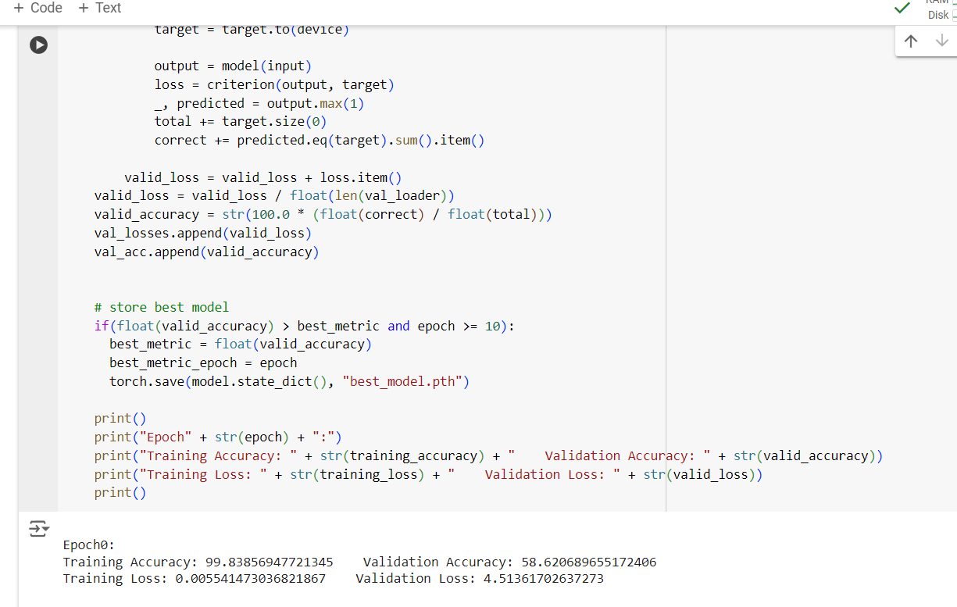
Results and Discussion:
The ResNet-50 architecture outperforms in terms of validation accuracy, reaching 99.83%.
ResNet-50's deeper architecture and residual connections likely contribute to its higher performance compared to the VGG models(VGG-16 & VGG-19).
ResNet-50 Accuracy:

Slide 16
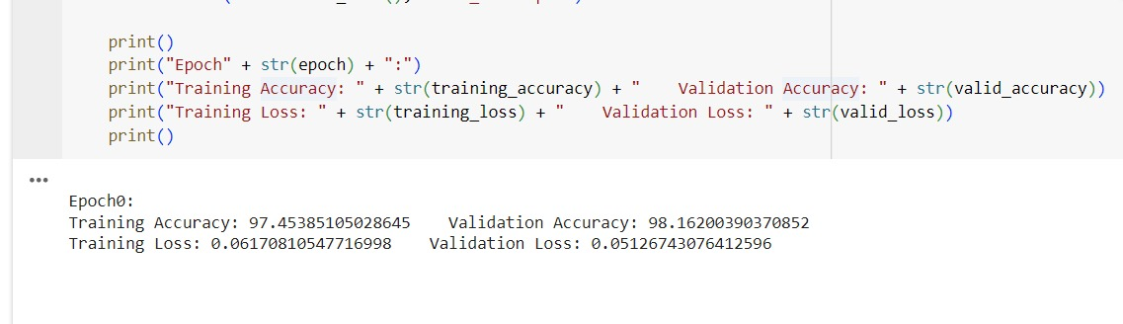
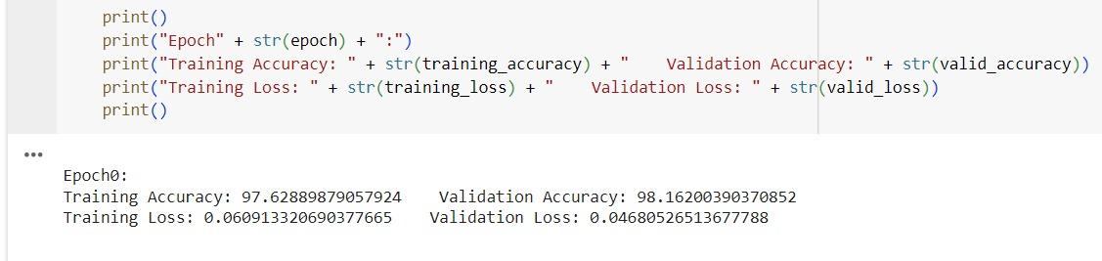
VGG-19 Accuracy:
VGG-16 Accuracy:

Slide 17
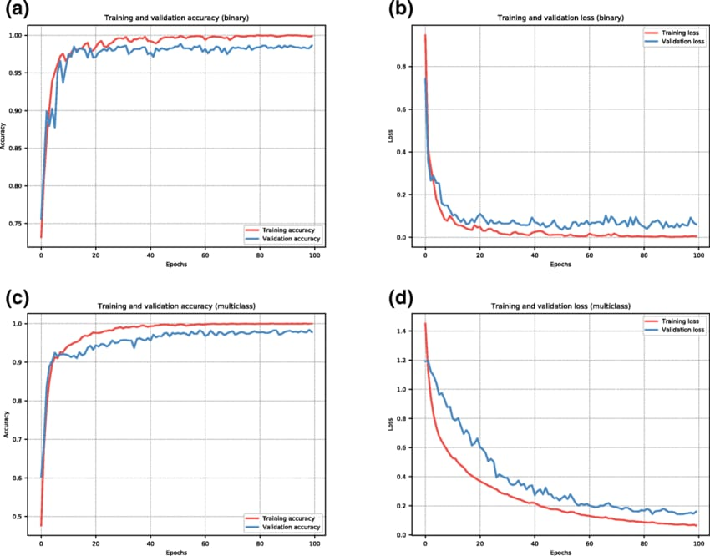

Slide 18
Reference:
F. Renard, S. Guedria, N. D. Palma, and N. Vuiller me, ‘‘Variability and reproducibility in deep learning for medical image segmentation,’’ SciRep, vol. 10, no. 1, p. 13724, Dec. 2020.
T. Lei, R. Wang, Y. Wan, B. Zhang, H. Meng, and A. K. Nandi, ‘‘Medical image segmentation using deep learning: A survey,’’ 2020, arXiv:2009.13120.
S. Pandey, H. Tekch and ani, and S. Verma, ‘‘A literature review on application of machine learning techniques in pancreas segmentation,’’ in Proc. 1st Int. Conf. Power, Control Com put. Technol. (ICPC T), Raipur, India, Jan. 2020, pp. 401–405.
X. Yao, Y. Song, and Z. Liu, ‘‘Advances on pancreas segmentation: A review,’’ Multimedia Tools Appl., vol. 79, nos. 9–10, pp. 6799–6821,Mar. 2020.
H. Kumar, S. V. De Souza, and M. S. Petrov, ‘‘Automated pancreas segmentation from computed tomography and magnetic resonance images:A systematic review,’’ Comput. Methods Programs Biomed., vol. 178,pp. 319–328, Sep. 2019.
O. Ronneber ger, P. Fischer, and T. B rox, ‘‘U-Net: Convolutional networks for biomedical image segmentation,’’ in Proc. Med. Image Com put. Com put.-Assist. Inter vent. Cham, Switzerland: Springer, 2015,pp. 234–241.

Slide 19


